Slide 1

SharePoint Lists - Part III
mintesnot

Slide 2

What is SharePoint Site Customization?

Slide 3
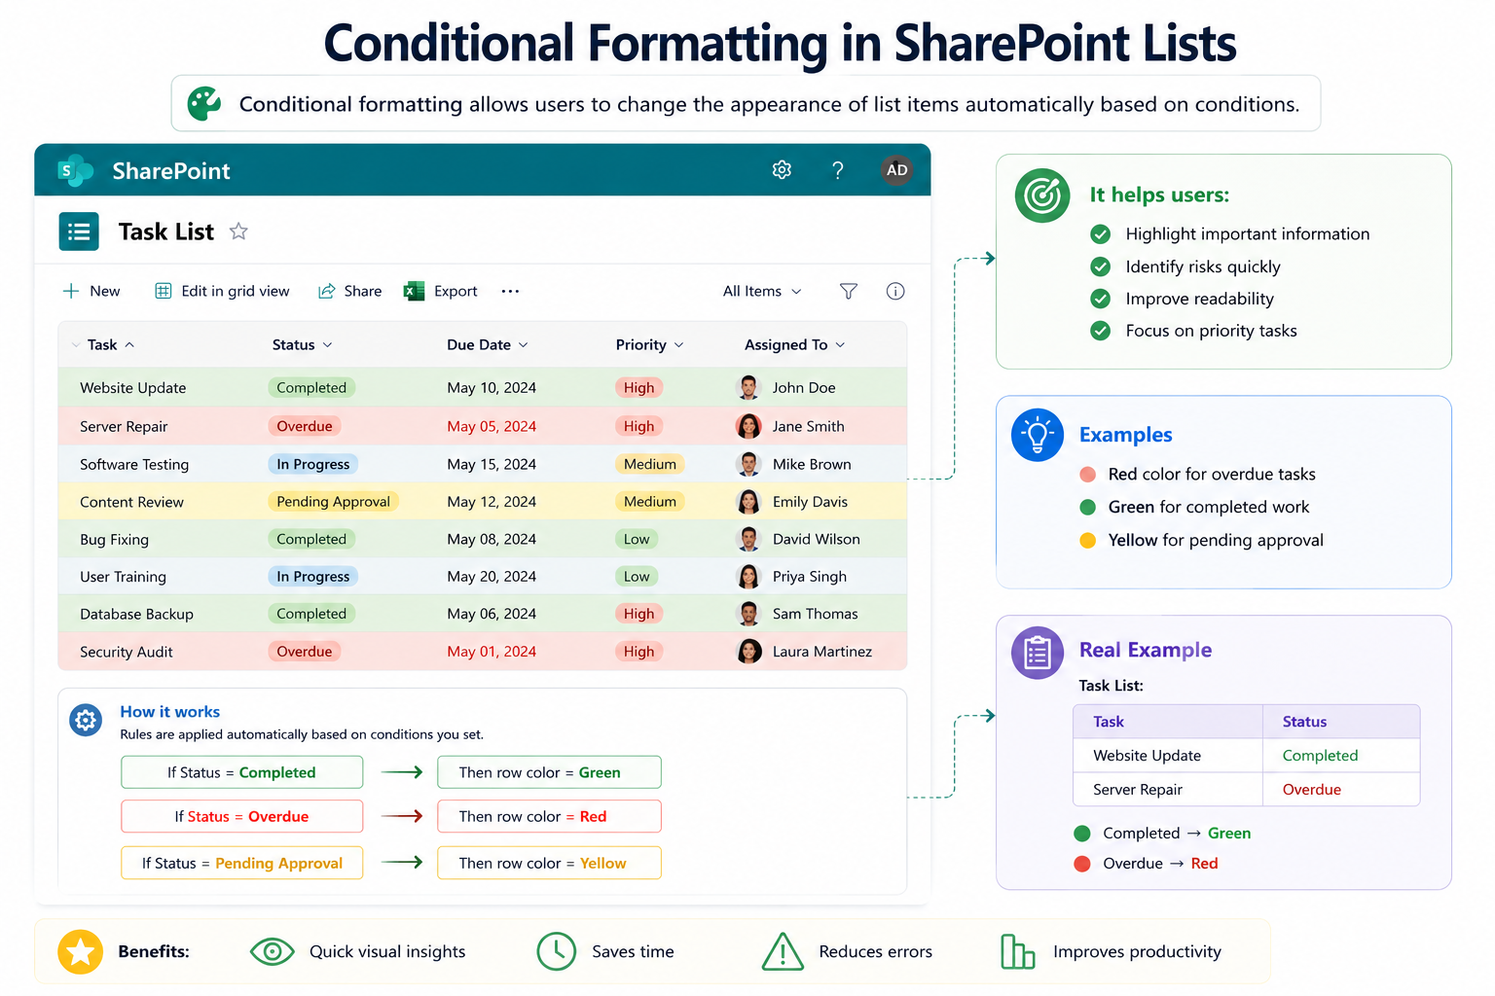
Conditional Formatting
Conditional formatting in SharePoint Lists allows users to change the appearance of list items automatically base don conditions
It helps users
✅ Highlight important information ✅ Identify risk quickly ✅ Improve readability ✅ Focus on priority tasks
Examples
Red color for overdue tasks
Green for completed work
Yellow for pending approval

Slide 4
Types of Conditional Formatting
Column Formatting | Row Formatting | View Formatting
Example: Status Column Completed → Green Badge Pending → Yellow Badge Rejected → Red Badge | Formats the entire row. Example: High Priority Tasks = Red Background | Changes appearance of the entire list view. Example: Gallery View for employee cards.
Benefits
✔ Easy visual identification ✔ Better user experience ✔ Faster decision-making

Slide 5
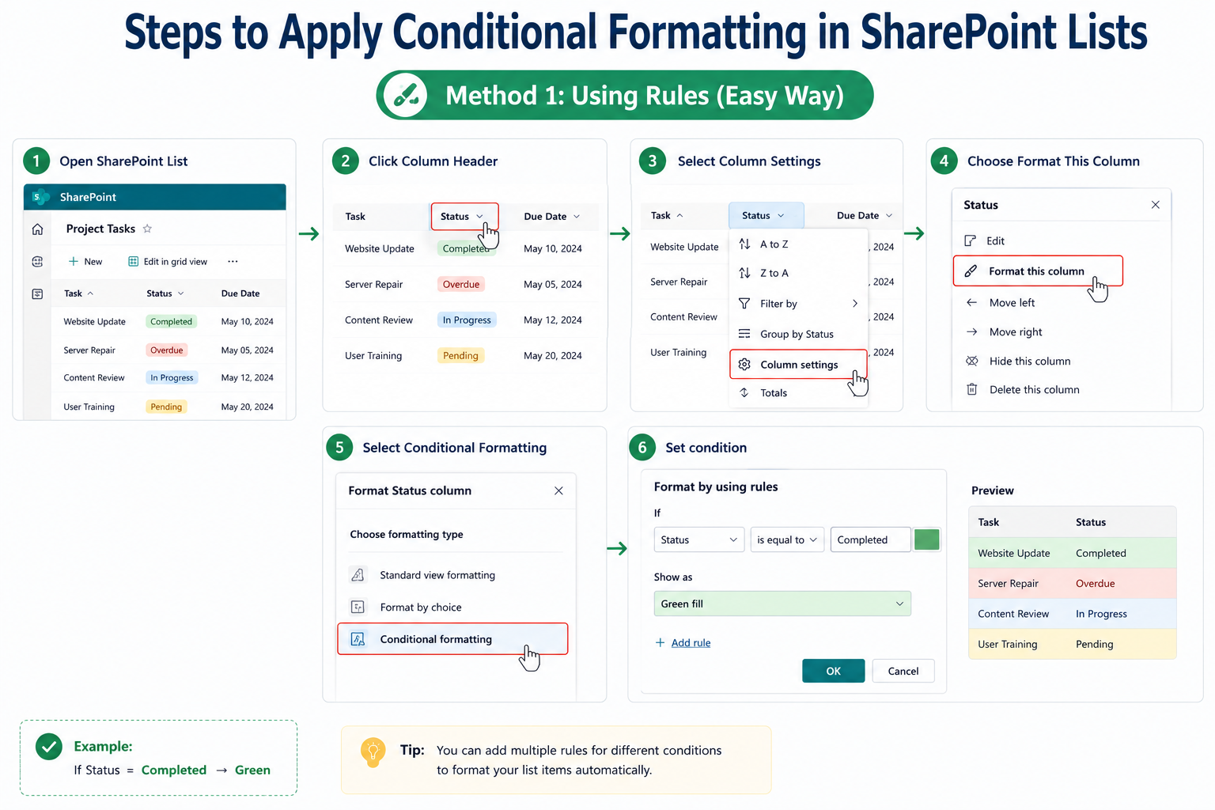
Apply Conditional Formatting
Method 1: Using Rules (Easy Way)
Open SharePoint List
Click Column Header
Select Column Settings
Choose Format This Column
Select Conditional Formatting
Set condition
Example:
If Status = Completed → Green

Slide 6
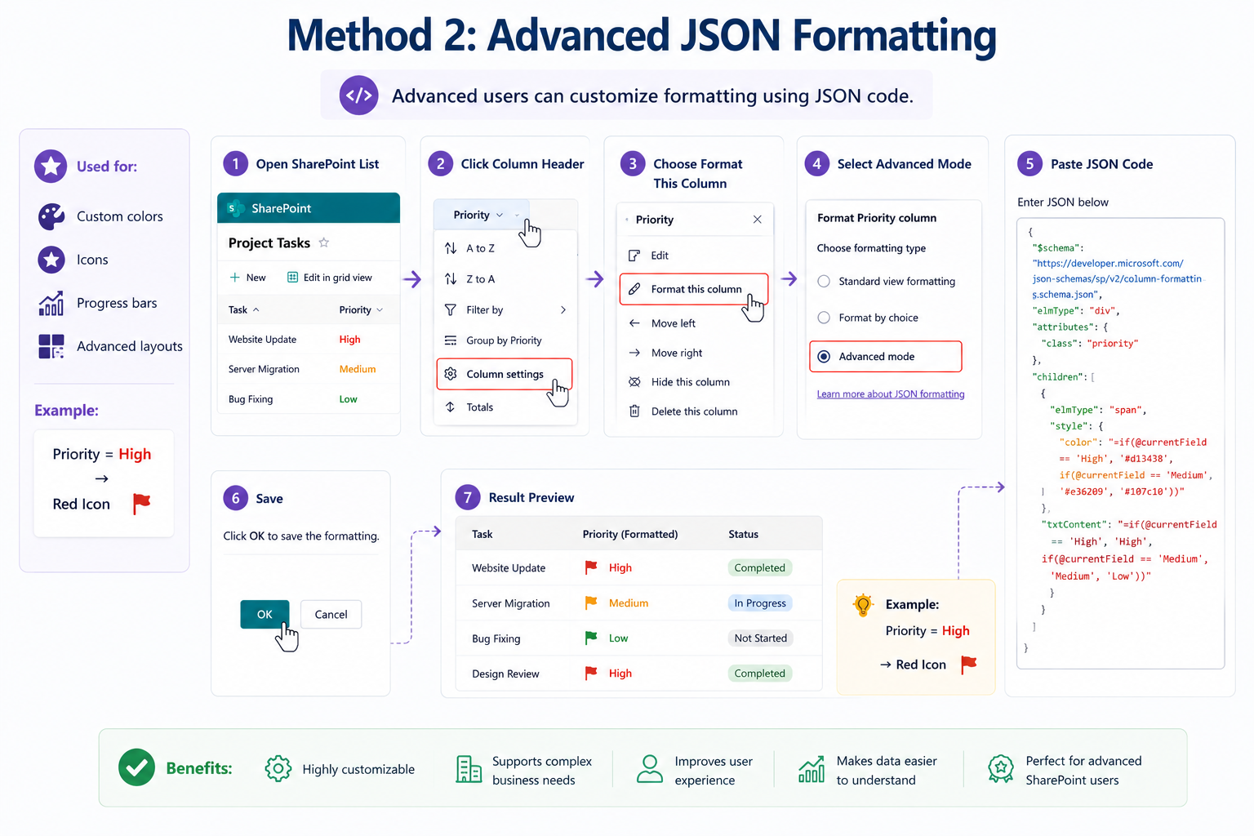
…
Method 2: Advanced JSON Formatting
Advanced users can customize formatting using JSON code.
Used for:
Custom colors
Icons
Progress bars
Advanced layouts
Example:
Priority = High → Red Icon

Slide 7
What is Versioning?
Versioning in SharePoint Lists allows SharePoint to

Slide 8

SharePoint Lists Vs. Microsoft Lists
Feature | SharePoint Lists | Microsoft Lists
Platform | Inside SharePoint | Standalone App
Access | SharePoint Site | Web, Mobile, Teams
Templates | Yes | More modern templates
Collaboration | Yes | Enhanced
Mobile Experience | Limited | Better
Backend | SharePoint | SharePoint
Key Difference
Microsoft Lists = Modern experience of SharePoint Lists

